Slide 1
Programming with Java
Anan Yaagoub - PhD
Northwestern University

Slide 2
Parallel Processing

Slide 3
What is Parallelism?
Performing multiple tasks (also known as processes) over a certain period of time by executing them concurrently.
Cooperative-Work between the OS and the Programming language applications
Many Languages has frameworks to support parallel processing
  Java
  Python
Older OS – did not support any kind of concurrency
  Can open one application at a time

Slide 4
Parallelism Classification
Multitasking
  One processor doing multiple tasks at the same time
    Context switching
    Preemptive scheduling
Multiprocessing
  Many processor working on a single task
      More than one CPU
      Multi-Core devices
      Computer nodes connected (Hadoop)

Slide 5
What is Multitasking?
Performing multiple tasks concurrently instead of executing the tasks sequentially.
As a result, a computer executes segments of multiple tasks in an interleaved manner, while the tasks share CPUs and main memory.
In the case of a computer with a single CPU:
  Only one task is said to be running at any point in time
  CPU is actively executing instructions for that task.
  Multitasking solves the problem by scheduling which task may be the one running at any given time, and when another waiting task gets a turn.
  The act of reassigning a CPU from one task to another one is called a context switch.

Slide 6
Multiprocessing
Many calculations are carried out simultaneously
Large problems can often be divided into smaller ones, which are then solved at the same time.
Parallel computing has become the dominant paradigm in computer architecture, mainly in the form of multi-core processors.
A Computational task is typically:
  broken down in several, often many, very similar subtasks
  that can be processed independently
  and whose results are combined afterwards, upon completion.

Slide 7
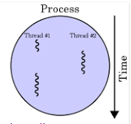
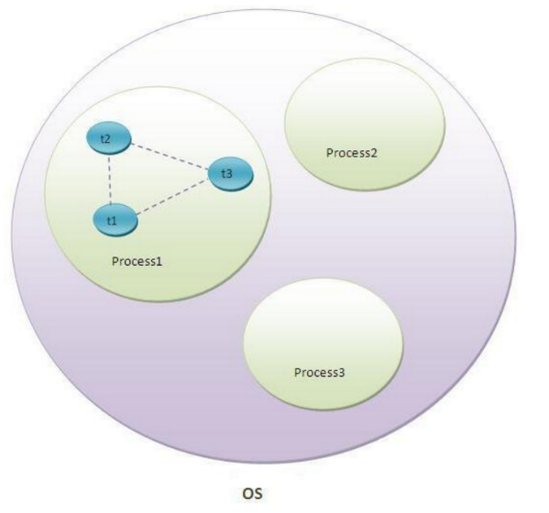
What is Threading
In computer science, a thread of execution is the smallest sequence of programmed instructions that can be managed independently by OS scheduler
A thread is:
  a stream of instructions within a process.
  Each thread has its own:
    instruction pointer
    Set of registers
    Stack memory.
  The virtual address space is process specific, or common to all threads within a process.
  Data on the heap can be readily accessed by all threads

Slide 8
Using Parallelism Comes with …
Processing Overhead
  Creation and Setup time
  Threads Communication times
  Context switching time
New Type of Errors
  Data corruption
  Deadlocks
  Slower outcome with bad design

Slide 9
Parallelism Benefits
Best User Experience
  Processing speedup
  GUI Response time
Background tasks
  Disk read/write
  Network communication
  WEB API calls
Servers
  WEB servers
  Database servers
Graphics
  Heavily used in game development

Slide 10
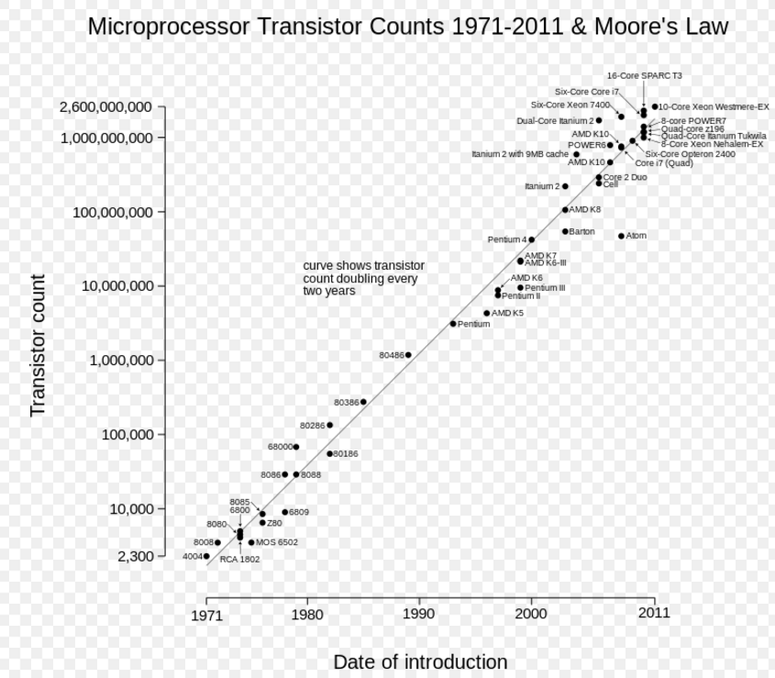
Moore’s Law
"Moore's law" is the observation that, over the history of computing hardware, the number of transistors in a dense integrated circuit has doubled approximately every two years.
Speed is a Free Lunch

Slide 11
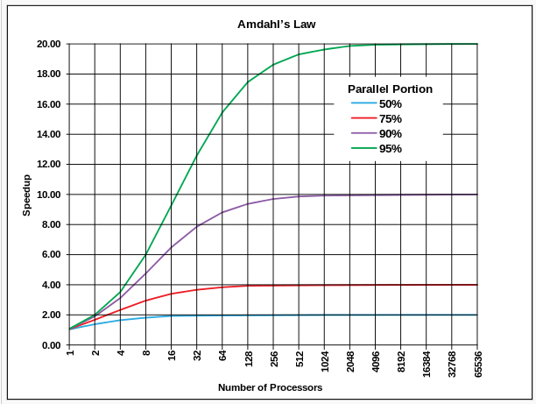
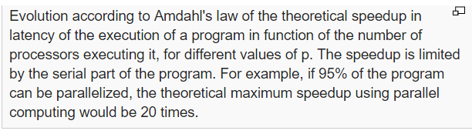
Amdahl’s Law
speed up of a program in parallel world is limited by the amount of serial part of the program

Slide 12
When to think parallel
Does it work for all tasks?
Candidate for parallelism:
  CPU intensive operations
  Sorting, search, filtering aggregation
  Background jobs … networking or saving file in background
Where not: network I/O ... have to wait … cannot speed that!

Slide 13

Threading in Java Overview
GOALS
To understand how multiple threads can execute in parallel
To learn to implement threads
To understand race conditions and deadlocks
To avoid corruption of shared objects by using locks and conditions
To use threads for programming animations
Solving problems in parallel
Language specific features (Java 8)

Slide 14
Running Threads
A thread is a program unit that is executed independently of other parts of the program.
The Java virtual machine executes each thread for a short amount of time and then switches to another thread.
This gives the illusion of executing the threads in parallel to each other.
Actually, if a computer has multiple central processing units (CPUs or Cores), then some of the threads can run in parallel, one on each processor.

Slide 15
Java: Running Threads – Method I
Write a class that implements the Runnable interface.
    public interface Runnable
    {
    void run();
    }
Place the code for your task into the run method of your class:
    public class MyRunnable implements Runnable
    {
      public void run()
      {
        Task statements
        . . .
      }
    }

Slide 16
Running Threads – Method I … cont.
Create an object of your subclass:
  Runnable r = new MyRunnable();
Construct a Thread object from the runnable object:
  Thread t = new Thread(r);
Call the start method to start the thread:
  t.start();
Example: SampleRunnable.java

Slide 17
Running Threads – Method II
Inherit directly from the Thread class
Override the run method
Create object of your class and call the start() method
    class myClass extends Thread{
    public void run(){
    …
    }
    }
    …
    myClass t1 = new myClass( … );
    t1.start();
Example: SampleThread.java

Slide 18
OS - Context Switching
Number of Threads can be more than number of processors
The thread scheduler gives no guarantee about the order in which threads are executed.
Each thread runs for a short amount of time, called a time slice.
Then the scheduler activates another thread

Slide 19
Thread Pools
A program that creates a huge number of short-lived threads can be inefficient.
Threads are managed by the OS and there is a cost for creating threads.
Each thread requires memory, and thread creation takes time.
This cost can be reduced by using a thread pool.
A thread pool creates a number of threads and keeps them alive.
When you add a Runnable object to the thread pool, the next idle thread executes its run method.

Slide 20
Thread Pools …
Java ExecutiveService Object
For example, the following statements submit two runnable to a thread pool:
  Runnable r1 = new GreetingRunnable("Hello");
  Runnable r2 = new GreetingRunnable("Goodbye");
  ExecutorService pool;
  pool = Executors.newFixedThreadPool(MAX_THREADS);
  pool.execute(r1);
  pool.execute(r2);
Example: ThreadPool.java

Slide 21
Thread Pools …
If many runnable are submitted for execution, then the pool may not have enough threads available.
In that case, some runnable are placed in a queue until a thread is idle.
As a result, the cost of creating threads is minimized.
However, the runnable that are run by a particular thread are executed sequentially, not in parallel.
Thread pools are particularly important for server programs, such as database and web servers, that repeatedly execute requests from multiple clients.

Slide 22
Terminating Threads
When the run method of a thread has finished executing, the thread terminates. (Normal)
Sometimes you need to terminate a running thread. You may have several threads trying to find a solution to a problem. As soon as the first one has succeeded, you may want to terminate the other ones.
In the initial release of the Java library, the Thread class had a stop method to terminate a thread. (deprecated and dangerous)
Instead a thread should be in charge of terminating itself.
To notify a thread that it should clean up and terminate, you use the interrupt method.
  t.interrupt();

Slide 23
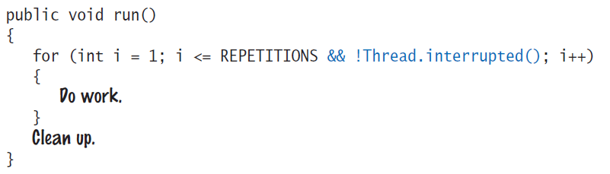
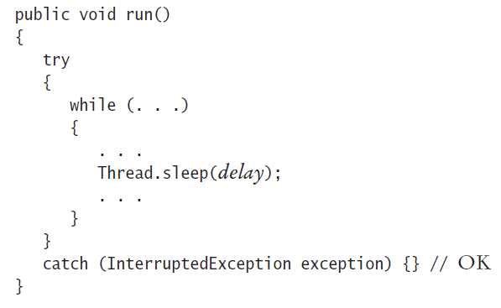
Terminating Threads

Slide 24
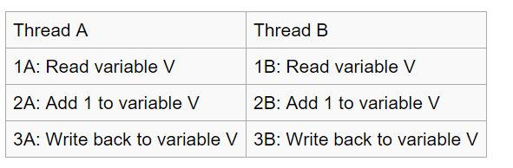
Race Conditions
Each thread has its own local and shared variables.
When threads share access to a common object, they can conflict with each other
That shared access creates a problem. This problem is often called a race condition.
Instructions level example
Example: PARALLEL2 – Bank Account

Slide 25
Synchronizing Object Access
To solve race condition problem, use a lock object.
The lock object is used to control the threads that want to manipulate a shared resource.
The Java library defines a Lock interface and several classes that implement this interface.
The ReentrantLock class is the most commonly used lock class. (In Java 5+)

Slide 26
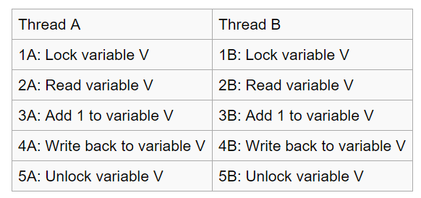
Race Conditions - LOCK
When threads share access to a common object, they can conflict with each other.

Slide 27
Synchronizing Object Access …
When a thread calls the lock method, it owns the lock until it calls the unlock method.
If a thread calls lock while another thread owns the lock, the first thread is temporarily deactivated.
The thread scheduler periodically reactivates such a thread so that it can again try to acquire the lock.
If the lock is still unavailable, the thread is again deactivated.
Eventually, when the lock is available because the original thread unlocked it, the waiting thread can acquire the lock.

Slide 28
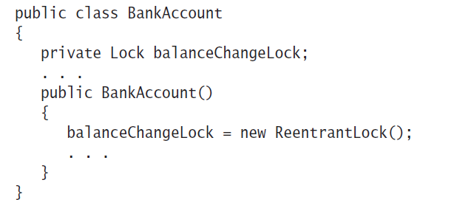
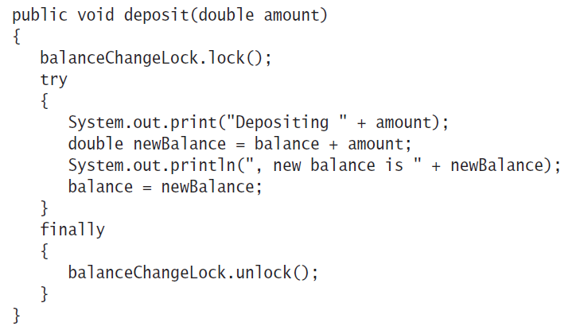
Synchronizing Object Access …
Example: PARALLEL 3 – Bank Account

Slide 29
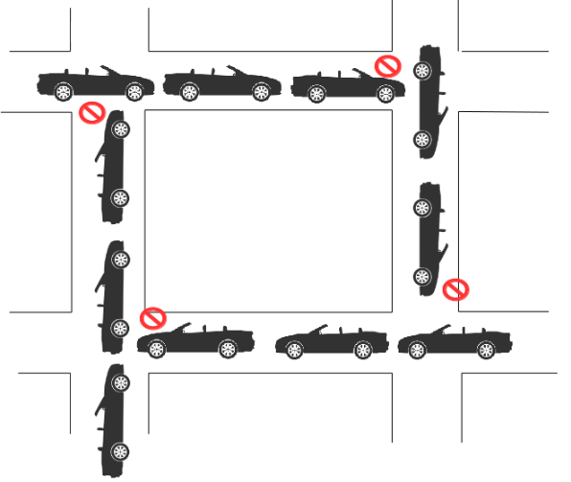
Avoiding Deadlocks
Use lock objects to ensure that shared data are in a consistent state when several threads access them.
However, locks can lead to another problem.
  One thread acquires a lock and then waits for another thread to do some essential work.
  The other thread is currently waiting to acquire the same lock.
  Neither of the two threads can proceed.
  Such a situation is called a deadlock

Slide 30
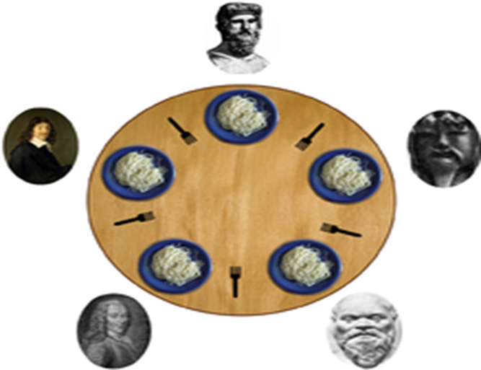
Deadlock – 5 Philosopher
Each philosopher is instructed to behave as follows:
  think until the left fork is available; when it is, pick it up;
  think until the right fork is available; when it is, pick it up;
  when both forks are held, eat for a fixed amount of time;
  then, put the right fork down;
  then, put the left fork down;
  repeat from the beginning.
Starvation!

Slide 31
Avoiding Deadlocks …
A deadlock occurs if no thread can proceed because each thread is waiting for another to do some work first.
To overcome this problem, we use a condition object.
Calling await on a condition object makes the current thread wait and allows another thread to acquire the lock object.
A waiting thread is blocked until another thread calls signalAll or signal on the condition object for which the thread is waiting.

Slide 32
Example: Search In Files
Search a number of text files
Independent tasks
File I/O example
Example: PARALLEL 4

Slide 33
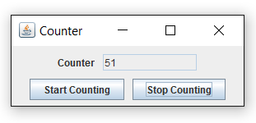
Example: Responsive GUI
Example: PARALLEL 5

Slide 34
Example: Graphics in Games
Game Programming
Example: PARALLEL 6

Slide 35
Java – Parallel Frameworks
Thread
  Since Java 5
  Require lots of managing code
Fork-Join frame work / API
  In Java 7
  Divide and conquer algorithm
Executor Framework / API … much easier
  In Java 8
  Create task definition class
  Provide task object to a executor service
  Auto creation and management of threads

Slide 36
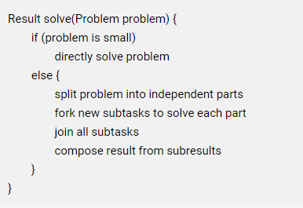
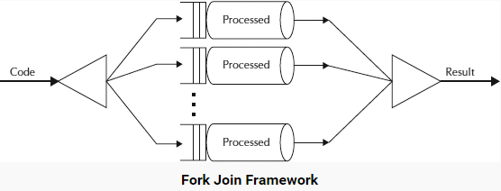
Example: Fork-Join framework
Recursively break down the problem into smaller sub problems
Solve the sub in PARALLEL
Combine the solutions to
sub-problems to arrive the final
results

Slide 37
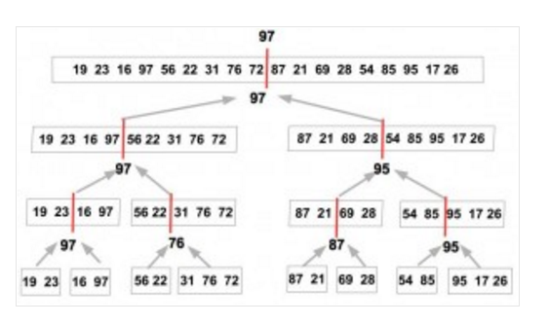
Example: Fork Join Framework
Find Max element in a list
public class MaxSearchTask extends RecursiveTask
Example: PARALLEL 7

Slide 38
Example: Java 8 parallel features
Arrays
  Parallel sort
  Example: PARALLEL – ParallelSort.java
Other Examples: Main, Synchronized, and Executor
Java 8
  Parallel Loops
  Streams
  Lambda expressions

Slide 39
GUI and DB

Slide 40
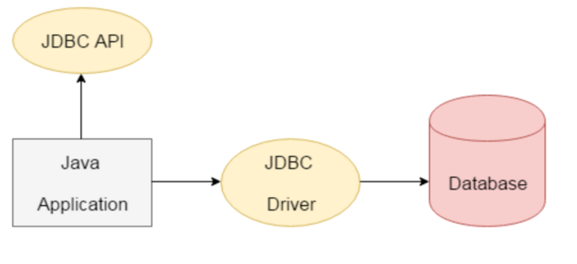
ODBC/JDBC
Java JDBC is a java API to connect and execute query with the database.
JDBC API uses JDBC drivers to connect with the database.

Slide 41
Install MySQL JDBC
Download the "latest" MySQL JDBC driver from: https://dev.mysql.com/downloads/connector/j/
Download ZIP or TAR file. Select "No thanks, just start my download".
UNZIP the download file into a temporary folder.
From the temporary folder, COPY the JAR file "mysql-connector-java-5.1.{xx}-bin.jar" to your JDK's Extension Directory at "<JAVA_HOME>\jre\lib\ext" (where <JAVA_HOME> is the JDK installed directory), e.g., "c:\program files\java\jdk1.8.0_{xx}\jre\lib\ext".

Slide 42
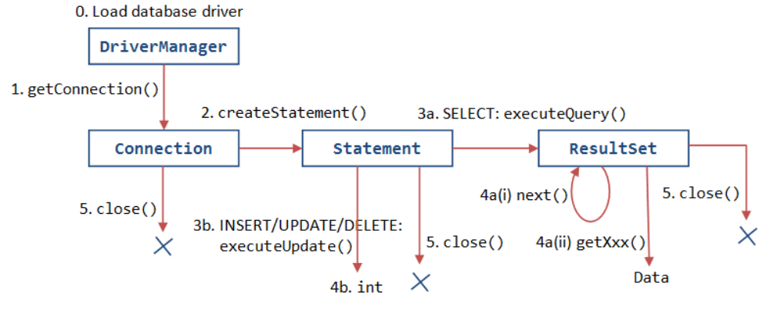
DB - Interaction
Connect
Create statement
Execute
EXAMPEL: DB

Slide 43
Java Graphics APIs - AWT
Abstract Window Toolkit is an API to develop GUI or window-based applications in java
Java AWT components are platform-dependent i.e. components are displayed according to the view of operating system.
AWT is heavyweight i.e. its components are using the resources of OS.
The java.awt package provides classes for AWT API such as TextField, Label, TextArea, RadioButton, CheckBox, Choice, List etc.
AWT component classes are now obsoleted by Swing's counterparts.

Slide 44
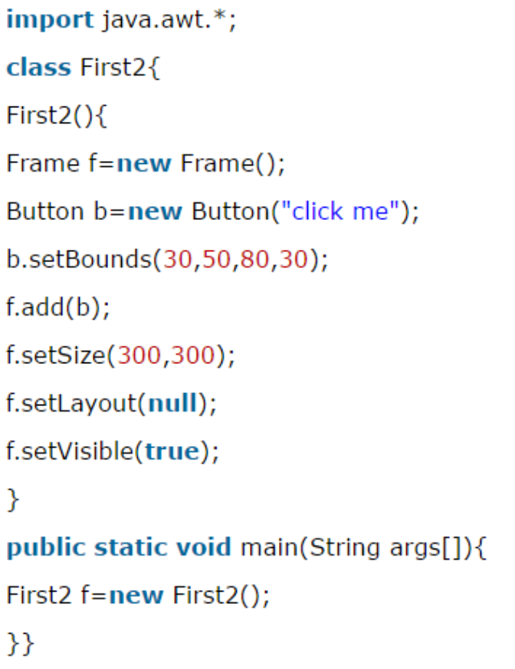
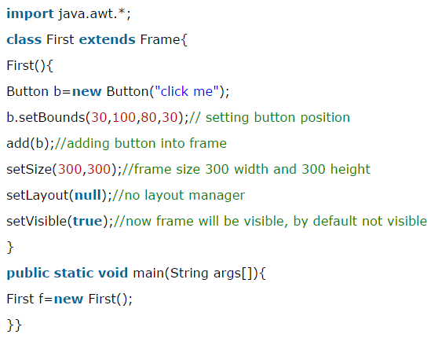
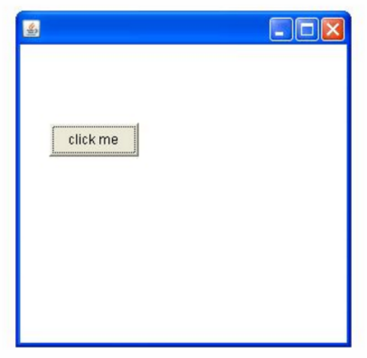
AWT Example by Inheritance/Composition

Slide 45
Java Graphics APIs - SWING
Java Swing is a part of Java Foundation Classes (JFC) that is used to create window-based applications.
It is built on the top of AWT (Abstract Windowing Toolkit) API and entirely written in java.
Unlike AWT, Java Swing provides platform-independent and lightweight components.
The javax.swing package provides classes for java swing API such as JButton, JTextField, JTextArea, JRadioButton, JCheckbox, JMenu, JColorChooser etc.
components that can be dragged and dropped as "GUI builders" in visual programming environment.

Slide 46
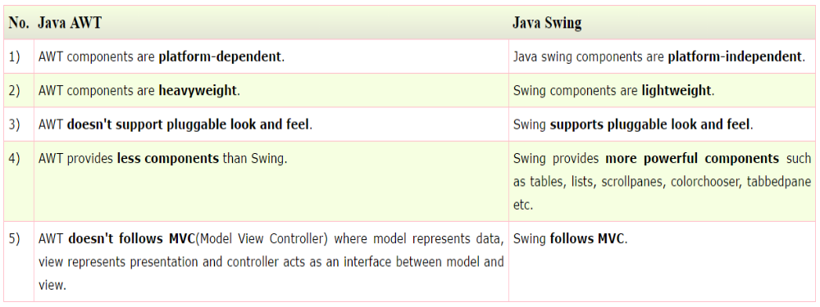
AWT vs SWING

Slide 47
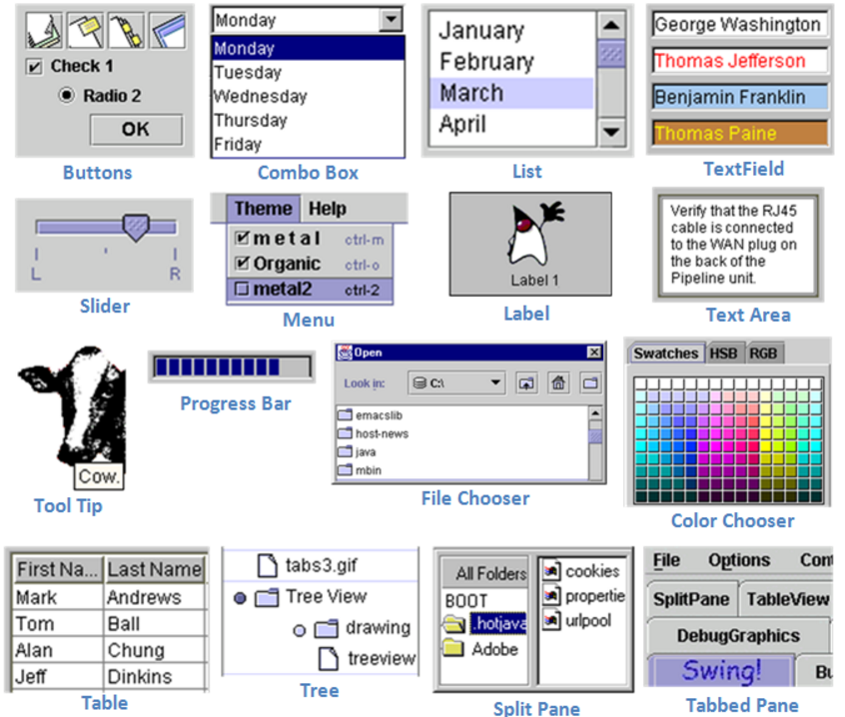
SWING - GUI Components

Slide 48
Layout Manager
The LayoutManagers are used to arrange components in a particular manner.
LayoutManager is an interface that is implemented by all the classes of layout managers.
There are following classes that represents the layout managers:
  java.awt.BorderLayout
  java.awt.FlowLayout
  java.awt.GridLayout
  java.awt.CardLayout
  java.awt.GridBagLayout
  javax.swing.BoxLayout
  javax.swing.GroupLayout
  javax.swing.ScrollPaneLayout
  javax.swing.SpringLayout etc.

Slide 49
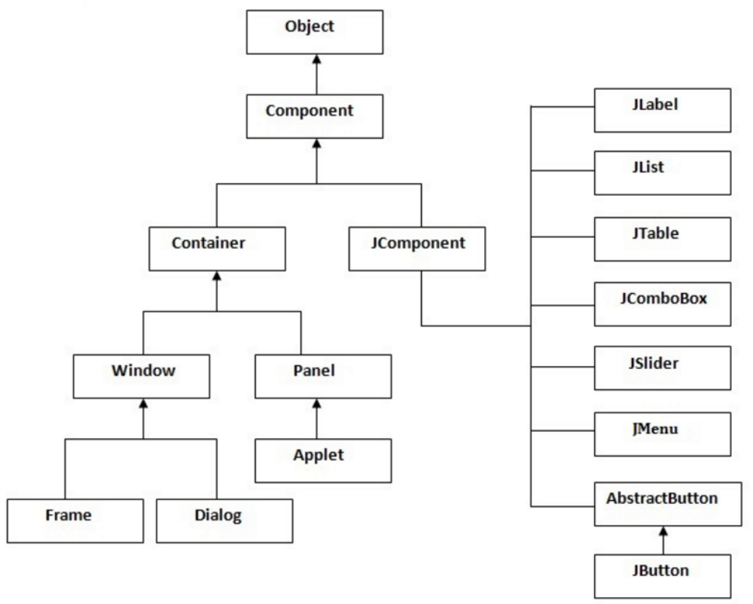
Hierarchy of Java Swing classes

Slide 50
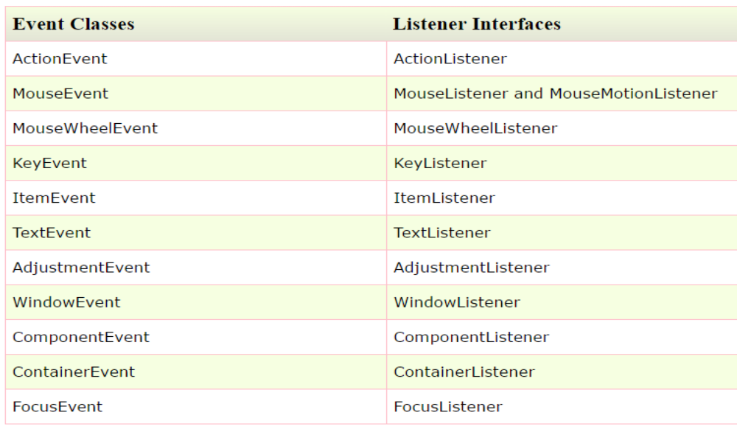
Java Event Handling
Changing the state of an object is known as an event.
For example, click on button, dragging mouse etc.
The java.awt.event package provides many event classes and Listener interfaces for event handling.
Java Event classes and Listener interfaces:

Slide 51
Java Event Handling
Steps to perform Event Handling
  Register the component with the Listener
  Many classes provide the registration methods. For example:
    Button: public void addActionListener(ActionListener a){}
    MenuItem: public void addActionListener(ActionListener a){}
    TextField:
      public void addActionListener(ActionListener a){}
      public void addTextListener(TextListener a){}
    TextArea: public void addTextListener(TextListener a){}
    Checkbox: public void addItemListener(ItemListener a){}
    Choice: public void addItemListener(ItemListener a){}
    List:
      public void addActionListener(ActionListener a){}
      public void addItemListener(ItemListener a){}
Java Event Handling Code (three different ways):
  Within class
  Other class
  Anonymous class

Slide 52
Event Handling - Within class
class myApp extends Frame implements ActionListener{
myApp(){
//create components
Button b=new Button("click me");
//register listener
b.addActionListener(this);//passing current instance
…
}
…
public void actionPerformed(ActionEvent e){
tf.setText("Welcome");
}
…
public static void main(String args[]){
new myApp();
}
}

Slide 53
Event Handling - Other class
class myApp extends Frame {
myApp(){
Button b=new Button("click me");
//register listener
Outer o=new Outer(this);
//passing outer class instance
b.addActionListener(o);
}
public static void main(String args[]){
new myApp();
}
}
class Outer implements ActionListener{
myApp obj;
Outer(myApp obj){
this.obj=obj;
}
public void actionPerformed(ActionEvent e){
obj.tf.setText("welcome");
}
}

Slide 54
Event Handling - Anonymous class
class myApp extends Frame{
myApp() {
Button b=new Button("click me");
b.addActionListener(new ActionListener() {
public void actionPerformed(){
tf.setText("hello");
}
});
}
public static void main(String args[]){
new myApp();
}
}

Slide 55
GUI Builder
Install Demo:
  https://www.youtube.com/watch?v=oeswfZz4IW0
EXAMPLE: GUI and GUI2

